Slide 1
Memory
Operating System Lab-in-a-Box

Slide 2
Previous
Concurrency
Lab
Notes:
In the previous presentation we learnt about “Concurrency”.

Slide 3
Current Presentation Content
Memory Hierarchy
Cache,
Entries, metrics, blocks,
Direct mapped cache, N-way set associative Cache, Fully associative Cache
Block replacement policy
Memory map
Memory management
Address binding and dynamic binding
Relocation register, Memory Partitioning
Buddy memory and non-contiguous memory allocation
Paging, Translation Look aside Buffer (TLB), Multilevel Page Table
Segmentation with Paging
Notes:
In this presentation we will learn about the details of the memory hierarchy, cache memory, paging, segmentation etc.

Slide 4
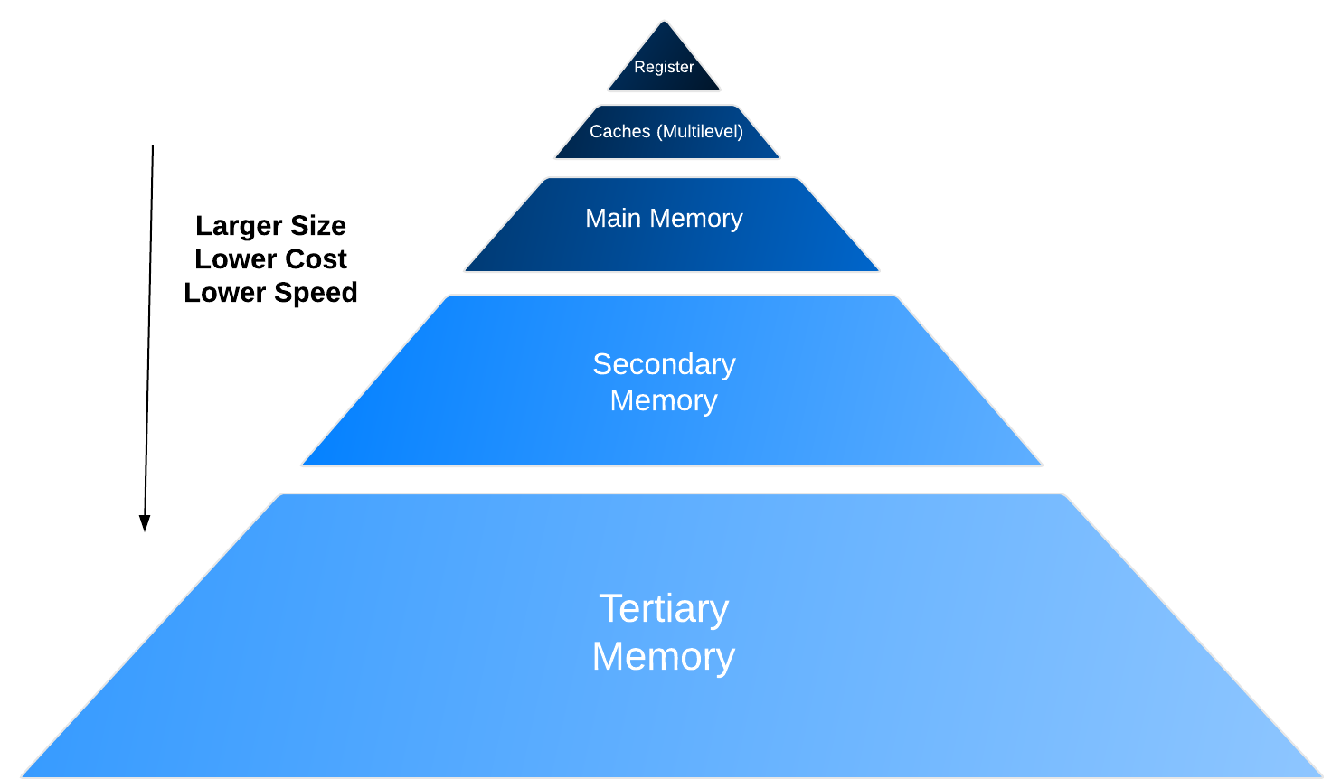
Memory Hierarchy
Register: usually one CPU cycle to access
Cache: CPU cache, TLB, Page cache
Static RAM
Main Memory: the “memory” memory
Dynamic RAM
Volatile
Secondary Memory: Hard disk
Tertiary Memory: Tape libraries
Temporal locality
Spatial locality
Memory Hierarchy – to exploit the memory locality
Notes:
A memory system is organized as a hierarchy of storage units with increasing capacities, costs, and access times. Frequently used data resides in CPU registers. Small, fast cache memory near the CPU has nearly 5 nano second access time and they store a few words of data from the main memory. The main memory has gigabytes of space with RAM ICs. The secondary memory and tertiary memory consist of a hard disk, floppy disk, tapes, and high capacity sequential storage devices.
Memory hierarchies provide average memory access time almost as the cache memory access time due to “temporal” and “spatial” locality:
Temporal locality means that the same piece of data in memory is used in the next few instructions. Spatial locality means that the data in memory that is close to the current piece data is often used.
If a required piece of data is found in a cache, it is a cache hit. If there is a cache miss, a block of words are brought from main memory to the cache and then sent to the CPU. The next CPU request would normally be to the block in the cache (Temporal and Spatial Locality). If the data requested is not found in main memory, then a page from secondary memory is brought into main memory and a block from this page is sent to the cache, then the required word is sent to the CPU.
Registers are very near the CPU and are connected by the internal bus of the CPU this means access time for registers are usually only one CPU cycle. The cache memory can be both, inside the CPU chip and outside the chip. They need a cache controller, translation look aside buffer, and cache page concepts. Main memory can be static RAM or Dynamic RAM (which requires frequent refresh to store the data). Secondary memory is slow and costs less per bit.

Slide 5
CPU Cache
Notes:
In the next few slides we will learn about cache memory.

Slide 6
CPU Cache - Why do we use cache
90/10 Rule
A typical processor spends 90% of its execution time in 10% of the total program code.
This means we can store the critical 10% of the code in a fast- accessible memory whereas leave the rest 90% on a storage disk
Locality of reference (or Principle of locality):
In many cases, a process accesses the same value, or related storage locations much more frequently than others
Temporal Locality - a process tends to reference in the near future those locations that have been referenced shortly before
For example, a for (;;) loop
Spatial Locality - a process tends to reference a portion of the address space in the neighbourhood of its last reference
For example, a data array
Notes:
Cache memory is a fast form of memory and it is also random access memory. The aim of cache memory is to hold the required data and program requested by the CPU most of the time. The 90/10 rule derived from empirical observation is: "A program spends 90% of its time in 10% of its code". This means that a program uses most of the time 10% of the code. If we keep this code in cached memory, then the CPU will be able to access it faster 90% of the time.
This phenomena is due to the following code behaviour:
Temporal locality, which means that recently accessed items are likely to be accessed in the near future.
Spatial locality, which means blocks of data in neighbouring locations will be accessed in the next few instructions.

Slide 7
CPU Cache Hierarchy
Cost
Speed
The CPU makes use of small, fast, and very expensive registers.
Main memory is cheaper and greater capacity but takes much longer to access.
The CPU cache is used to exploit locality – keeping copies of data likely to be used again in faster access memory to reduce the average time taken to access the data.
The cache sits in-between the fast static CPU registers, and the slow memory both in terms of cost and speed.
CPU
Cache – static RAM
Main Memory – dynamic RAM
Storage – Hard drive, FLASH
Notes:
The cache memory sits next to CPU and before the main memory, this can be seen in the diagram about the CPU Cache Hierarchy. As we can see the order is CPU registers, cache memory (static RAM), main memory (dynamic RAM), and then finally secondary memory (hard drive, flash, etc.).
The cost per bit of storage comes down as we move from cache to secondary memory. The size of the memory from cache to secondary memory is increasing and the speed of access from cache to secondary memory also increases. Memory design with multiple types of memory like cache is to bring down the over all memory system cost and provide high speed memory access.

Slide 8
Cache Entries
The cache operates as follows:
Whenever the CPU needs to read from a location residing in main memory, it first checks the cache for any matching entries.
If the location exists in the cache it is simply returned directly to the CPU – this is known as a cache hit.
If the location doesn’t exist in the cache, also known as a cache miss, the cache allocates a new entry for the location, copies the contents from main memory, and then fulfils the request from the contents in the cache.
Writing works in a similar fashion – the contents are written to the cache and then periodically propagated through to main memory.
The proportion of accesses that result in hits, as opposed to misses, is known as the hit rate and is a useful measure of the effectiveness of the cache.
Notes:
The cache operation is as follows: The CPU requests some data from a memory location. If the data is in the cache, it is called a cache hit and the cache sends the data to the CPU. Cache hit rate is nearly 99.99%. If there is a cache miss, then a block of data around the CPU’s requested address is brought from main memory and placed into the cache. Then the requested word is supplied to the CPU. If the cache is full, then we need to remove one of the blocks and bring in the new block using a replacement algorithm.

Slide 9
Some Cache Metrics
Memory cycle time
The minimum delay between two memory operations
Memory access time
The elapsed time between start and finish of memory access
Bandwidth – data throughput
Bandwidth = bit rate * number bits
Cache Hit:
Cache Hit Time: elapsed time in finding and retrieving data from the cache
Cache Hit Rate: proportion of cache hits to cache misses
Cache Miss:
Cache Miss Penalty: time required to retrieve data from main memory (as opposed to cache)
Cache Miss Rate = 1 – Cache Hit Rate
Average memory access time, or AMAT, can be calculated as follows:
AMAT = Cache Hit time + (Miss rate x Miss penalty)
Notes:
Cache performance is measured via the following metrics: Memory cycle time, memory access time, band width, cache hit, cache miss, and average memory access time.

Slide 10
Decreasing the Miss Penalty
Operate the main memory in ‘Burst Mode’ – once an address has been accessed, subsequent addresses can be accessed with a much lower overhead
Widen the memory and its cache interface so multiple words can be read in one shot
Organise the memory into banks that allow multiple reads and writes in parallel using interleaving – cheaper than implementing a wider bus for much the same speed
CPU
CPU
Cache
Cache
Main Memory
Main
Memory
Bank 0
Bank 1
Bank 2
Bank 3
Wide Bus Memory
Interleaved Memory
Notes:
“Miss penalty” refers to missing the data needed by CPU in the cache. Miss penalty = Fetch time + Replacement overhead + Conversion overhead . If there is a miss, we need to fetch a block of data from main memory, replace a block from the cache and store this new block at that location and there is a time delay to convert the logical address sent by CPU to a physical address in main memory. To reduce the miss penalty, we need to reduce all the three time delays.
Fetch time can be reduced by reading data from main memory in burst mode to read a block of data with a low overhead. We can have a multiple word wide data bus between cache and main memory to help in reading multiple location data in a single read.
If we have multiple banks of main memory in an interleaved manner, then multiple reads and writes in parallel can be implemented. The interleaved memory causes sequential memory addresses evenly across all the memory banks.
Example: Bank 0 has location $1000, Bank 1 has location $1001, and so on.

Slide 11
Cache Blocks
Often data is moved from main memory to the cache in blocks as Blocks rather than single bytes to take advantage of spatial locality – a prediction that access to one address will be followed by access to a nearby address.
The cache blocks contain only a subset of the main memory, therefore multiple memory addresses map to the same cache location. How do we tell which one is in there?
Answer: divide memory address into three fields:
The block index determines which set to look in when searching for a location.
The block tag distinguishes between all the main memory locations that map to the same cache index.
The block offset identifies the byte offset within the block.
A set is a grouping of slots in which a block can reside. For example if sets contain two blocks the cache can hold two memory blocks that map to the same cache location.
Block Address
Block
offset
Tag
Index
Set Select
Byte Select
Notes:
Blocks can also be known as cache lines. Block size is in the range of 4 bytes to 16 bytes, then to address a byte within a block we need either 2 bits to 4 bits.
If a word of data is missing in the cache, then a block of data is brought from main memory. Main memory has multiple frames of data and the frame size may be of 4 Kbytes. Only the correct block of data from the correct frame needs to be brought from main memory to the cache. To do this, the memory address is divided into 3 fields: Tag, index and block offset.
The block tag identifies the main memory locations that map to the same cache index.
The block index determines which set to look in when searching for a location in the cache.
The block offset identifies the byte offset within the selected cache block.
A set is a grouping of slots in which a block can reside. For example, if sets contain two blocks, the cache can hold two memory blocks that map to the same cache location.

Slide 12
Placement
The cache is limited in size, therefore it must be determined where newly fetched blocks should be placed in the cache, here we will look at three common placement policies:
Direct Mapped
Set Associative
Fully Associative
Notes:
Mapping a block in the cache to a frame in the main memory is done in 3 ways:
Direct mapping
Set associative mapping
Fully associative mapping

Slide 13
Direct Mapped Cache
In a Direct Mapped Cache each block has only one slot (set size of 1) in which it can reside in the cache.
This results in a simple design, but can be problematic when memory locations repeatedly map to the same cache slot and knock each other out.
Pros:
Simple design - inexpensive
Low number of indexes – quicker to search – therefore fast
Cons:
Low flexibility can lead to low hit-rate.
Notes:
Also known as a one-way set associative cache.
The main memory can be divided into a number of blocks. If the cache can store only 4 blocks, then the main memory block mod 4 will be the address to map on the cache.
It is a simpler design, but, may lead to a low hit rate. See the diagram in the next slide.

Slide 14
Direct Mapped Cache
Example: 32-block (5-bit) address space; 4-byte words; 8-block cache
Access byte 2 of block 12 (01110).
Cache
Block 12; Addr: 01110
01234567
111111111122222222233
0123456789012345678901234568901
3-bit index maps each block to a single cache slot.
4 memory blocks map to each cache slot, differentiated by 2-bit tag.
01
110
10
Tag (2-bits)
Index (3-bits)
Byte
Select (2-bit)
Notes:
Once the slot is determined through the index, only one single tag comparison is needed to see whether the memory location exists or doesn’t exist – cheap in terms of hardware and time.

Slide 15
N-Way Set Associative Cache
A block can be placed in N slots in an N-Way Set Associative Cache.
A block is first mapped to a set, and then can be put in any available slot within the set.
This goes towards solving the problem with memory locations repeatedly mapping to the same slot.
How it is placed within the set depends on the Replacement Policy (covered later).
Pros:
The main advantage of the Set Associative cache is that is combines the speed of direct mapping with the flexibility of fully associative caches.
Cons:
Finding blocks within a set requires more complex hardware – more expensive in terms of cost and time
Notes:
This N-Way policy is equivalent to N direct mapped caches operating in parallel. See the figure in the next slide.
The advantage is that it provides better hit ratio. Since N blocks for each set can reside in the cache.

Slide 16
N-Way Set Associative Cache
Example: 2-Way Set; 32-block (5-bit) address space; 4-byte words; 8-block cache
Access byte 2 of block 12 (01110).
Cache
Block 12; Addr: 01110
01234567
Set
0
1
2
3
111111111122222222233
0123456789012345678901234568901
2-bit index maps each block to a set that contains 2 slots.
8 memory blocks map to each cache slot, differentiated by 3-bit tag.
011
10
10
Tag (3-bits)
Index (2-bits)
Byte
Select (2-bit)
Notes:
2 memory blocks to search through to determine if a memory location is in the cache – more expensive in terms of hardware and time.

Slide 17
Fully Associative Cache
In a Fully Associative Cache a block can be placed in any available slot.
Makes the cache more flexible, increasing the hit rate
More complex, as searching for a block involves comparing all slots.
Pros:
Good flexibility - greater hit rate
Cons:
Requires large comparator to search for blocks within sets, which is expensive and slow
Notes:
In a Fully Associative Cache a block can be placed in any available slot. See the figure in the next slide.
Makes the cache more flexible, increasing the hit rate.
More complex, as searching for a block involves comparing all slots.
This provides more hit rate, but introduces complexity for searching a particular block.

Slide 18
Fully Associative Cache
Example: 32-block (5-bit) address space; 4-byte words; 8-block cache
Access byte 2 of block 12 (01110).
Cache
Block 12; Addr: 01110
01234567
111111111122222222233
0123456789012345678901234568901
No index, block can be placed anywhere in the cache.
Each block is identified in the cache by a 5-bit tag.
01110
10
Tag (5-bits)
Byte
Select (2-bit)
Notes:
8 memory blocks to search through to determine if a memory location is in the cache –expensive in terms of hardware and time.

Slide 19
Associativity Trade-off
The level of associativity is a trade-off when considering N-Way caches
The more slots available (bigger the set) for a block requires more searching, which costs time and power – however more slots increases the flexibility and therefore the hit rate.
Notes:
This N-Way policy is equivalent to N direct mapped caches operating in parallel. Typically a 2 way set associative mapping is utilized.

Slide 20
Block Replacement Policy
In a Direct Mapped cache there is no choice as to where to put a block. However with associative caches there is more than one slot to choose from when a block is retrieved.
Some common replacement policies:
Random – new block replaces randomly selected block, easiest to implement
Round Robin – first-in, first-out (FIFO); new block replaces oldest block – easy to implement
Least Recently Used – new block replaces least recently used block, requires extra complexity to track block usage
Notes:
In a fully associative cache, there are multiple block slots in the cache where a block from main memory can reside. The replacement of a block in the cache can be done with replacement policies such as:
Random
Round robin
Least Recently Used (LRU)

Slide 21
Memory Management

Slide 22
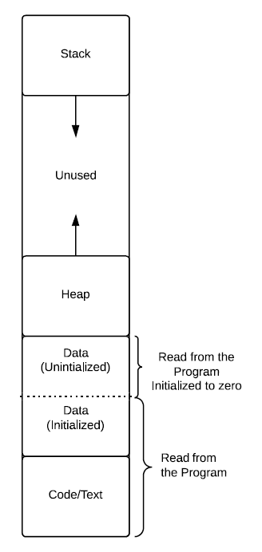
Processes Need Memory
Code or Text
Binary instructions to be executed
A clone of the program
Usually read-only
Program counter (PC), points to the next instruction
Static Data
Global/Constant/Static variables - shared between threads
If not initialized by program, will be zero or null pointer
Heap
malloc/free
Stack
Used for procedure calls and return
Stack Pointer(SP)
First In Last Out (FILO)
Notes:
Typically, computer memory is used to store program code, application data, space to store modified /computed data, heap, and stack.
The program or code memory location is identified by the “Program Counter”. The Program counter (PC) within the CPU is a register which contains the address of the next program instruction.
The static data stored in the memory are the global/constant/static variables that may be shared between threads or subroutines. They are normally initialized or zeroed. Heap is an area reserved for the program. “Malloc/Free” are the commands to allocate memory and to free up the memory space. Stack is a separate area or memory used for storing context switch information, return address to main program, intermediate values etc. The Stack pointer register points to the top location of the stack memory. Usually stack grows from higher memory address to a lower address. Stack behaves like first-in, last-out (FILO) or LIFO (last input comes out first).

Slide 23
What Does Memory Management Do?
Both the OS and user processes need memory
Allocation/Partition – compact way of allocating
Relocation – changing the memory space dynamically, ideally translation done by hardware
Protection – illegal reference to other processes’ memory should be detected and stopped at run time
Sharing – several processes access common part of the memory
Notes:
Memory management provides ways to dynamically allocate portions of memory to programs as needed, and deallocate it when it is no longer needed.
Memory management protects the memory of one process from another process’s access.
Common memory or shared memory is allowed to be shared by processes.

Slide 24
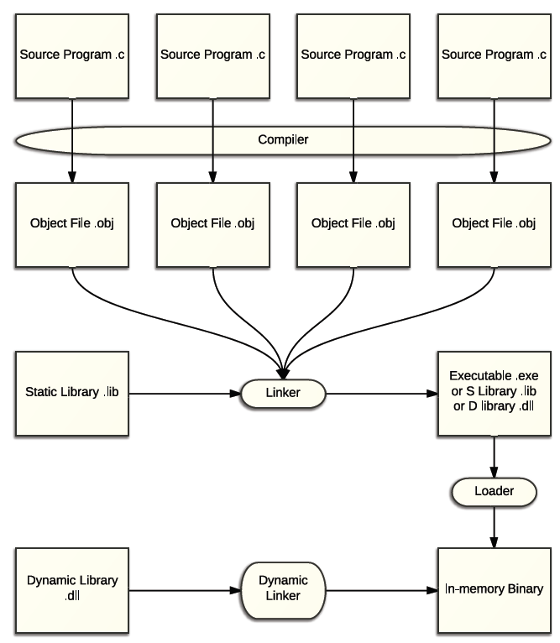
Address Binding
Where is the variable in memory and where is the location that the program is branching to?
Needs to map the program to main memory
Symbolic addresses in the source program
Instructions in the source program
Steps to run your program:
Compilation – convert symbolic references into numerical values and turn everything into machine code. Also contains placeholders and offsets as the linker will solve them.
Linking – either static or dynamic. It is possible to load and link libraries at run-time.
Loading – load the program into the main memory and all other necessary preparation
Notes:
By using the address binding method we map the program's logical or virtual addresses to corresponding physical or main memory addresses. A given logical address is mapped by the MMU (Memory Management Unit) to a physical address. To fetch every instruction/data from memory, CPU creates a logical or virtual address.
The logical address is translated to physical address by the MMU or address translation unit.
The variable location in memory or the location of program in memory are taken care of by address binding concepts. To run a program, the compiler converts symbolic references to for example physical address, links the static and dynamic library codes and loads them into program memory (in main memory).

Slide 25
Address Binding
Static Address Binding at
Programming
Programmers know the exact address they want
Compilation
Memory location known before execution
Absolute code and less flexible
Loading
Simple - relative to the beginning of the executable (offset)
Program starts at location L, then L is added to all memory addresses in the program
Not flexible enough – what if swapped out?
Dynamic Address Binding at runtime
Flexible – can relocate processes
At the cost of complicated address translation
Notes:
Address binding is the process of mapping the program's logical or virtual addresses to corresponding physical or main memory addresses. The address binding can be static or dynamic.
In the static method, the programmer knows or uses fixed addresses for data etc., and the compiler knows the memory locations for variables etc. before execution. The static address binding is easy, but less flexible. If the program is moved to a different location or the data is moved, then static address binding is not good.
Dynamic address binding is done during run time. It is flexible, but address translation needs to be done before fetching the program’s data and next instruction.

Slide 26
Dynamic Address Binding
Relocation is very frequent due to compaction and swapping
If static binding, needs explicit programming for the relocation
Alternatively, make OS handle it at runtime
Bind a logical/virtual address to a physical address
Physical address – absolute location in the main memory
Logical address – a reference to the physical address, should be independent of the organization and structure of the physical memory
Conceptually, PhysicalAddress = address_translation (LogicalAddress)
All translation is done by the component called the memory management unit (MMU)
How to implement the address_translation?
Relocation Register – relative address and continuous memory
Page/Multi-Segment – non–continuous memory
Notes:
A process can be swapped temporarily out of memory to a backing store, and then brought back into memory for continued execution, this causes relocation of the process. In dynamic address binding, the OS handles this relocation at run time as it binds the logical/virtual address to a physical address in main memory. This translation is done by the Memory Management Unit (MMU). This address translation can be implemented using relocation registers or using Page/Multi-segment techniques.

Slide 27
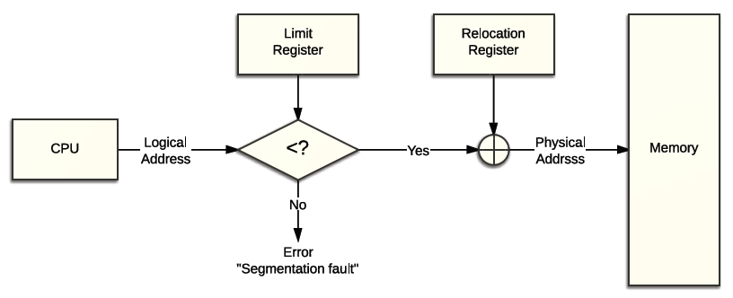
Relocation Register
OS writes the base address b into the relocation register and a hardware adder will automatically translate the program referred address (relative address) a to a+b.
For protection purpose, check if the relative address is out of range, using a comparator and the limit register (a<l?). Address fault if not and OS has to handle the error.
So, the OS only needs to modify the relocation register for swaps/compactions
Memory space from b to b+l can also be called a segment.
Notes:
Relocation register is loaded with a base address value (which is a valid physical address). The CPU sends a logical address and the OS compares it with the limit register to check whether it is out of range. If it is within range, it is added with the relocation register value to get the physical address.
Whenever the OS swaps the contents of main memory with secondary memory, the OS will change the value of the relocation register. Hence, there will be no problem due to swaps or compactions.

Slide 28
Relocation Register
This can be extended to a multi-segment scheme
Different segments for different types of data e.g., text/stack/data
Logical address: (segment-id, offset), for different segments, we have different b and l
Each process possesses a unique segment table stores related translation information
So the question is how can you determine
b
l
Memory Partitioning
Two Schemes:
Fixed
Dynamic
Notes:
Multiple segments of memory can be used for different types of data (e.g. Stack, Heap…). Each process has a unique segment table with translation information. Memory is partitioned as segments, one or more segments for each process.
Memory is partitioned by two schemes: Fixed and dynamic.

Slide 29
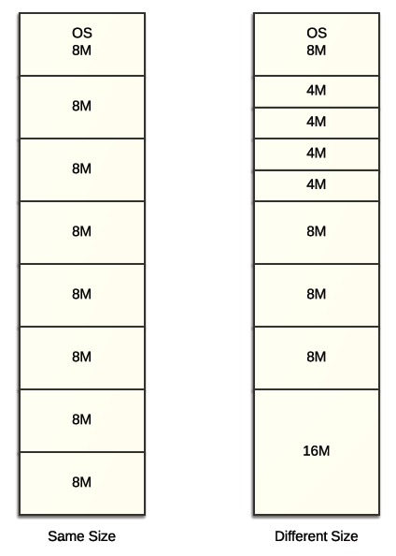
Memory Partitioning
Fixed b
l can either be fixed or not.
No overlapping and the boundary is fixed for all chunks.
Does the memory space for a process grow/shrink?
What if a process requires more than 8M?
Program should be explicit enough to handle this
Or a larger l?
What if a process only needs tiny space?
Regardless of the size, a whole chunk is allocated
Internal fragmentation - waste of space
Different size chunks may help but not so thoroughly
Notes:
In the fixed scheme of memory partitioning, the base value for each segment is fixed and each segment is of same size. In the example above the segment size is 8Meg for each segment.
In the dynamic scheme of memory partitioning the base value is not fixed for each segment. The limit (or size of the segment) is also not fixed. They are assigned values during run time.

Slide 30
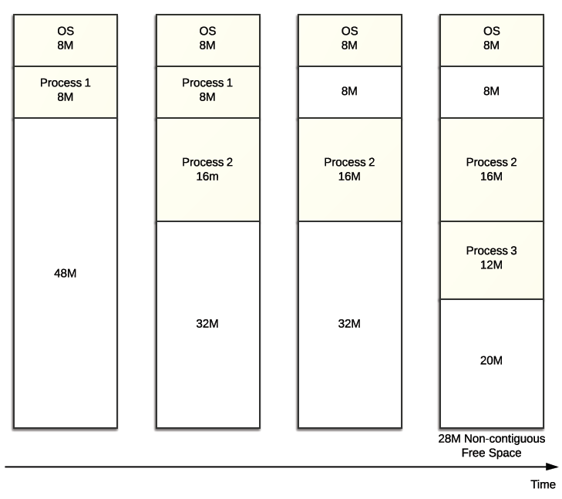
Memory Partitioning
Variable I
Choose a suitable size, slightly larger than what is required
External fragmentation
Variable b
Many options, which to go? To reduce fragmentation
Very dynamic scheme and OS has to keep track of all related information
Responsive – find a hole quickly enough
Coalescing – merge adjacent free holes
Notes:
The operating system assigns a value for L the limit of the segment (or size) and it is chosen a bit larger than what is required or expected. If it grows more than this size, then another segment needs to be assigned. This can cause “Fragmentation”.
Memory Fragmentation can occur when memory for a process is allocated in a non-contiguous block in main memory. In between used blocks, there may be many small unused blocks, this may cause a large portion of memory unallocated. This results in memory exceptions, or allocation errors.
The operating system assigns values for B, base register value to reduce fragmentation. The OS has to keep track of the used/allotted locations in memory to find a hole for new segments. Coalescing is the method for merging adjacent free holes to create a bigger free memory space so that a new segment can occupy that space.

Slide 31
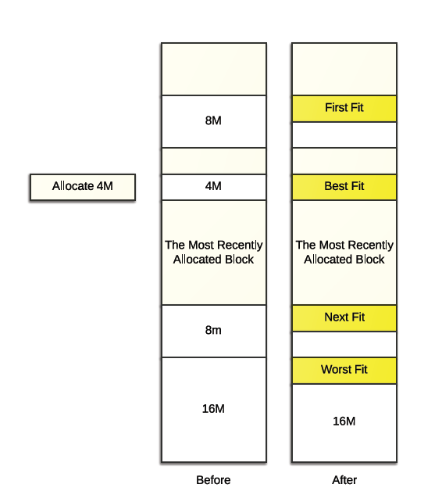
Memory Partitioning
Variable b – Some algorithms
First fit – first large enough hole
Next fit – first large enough hole from where last search ended
Best fit – smallest large enough hole
Worst fit – largest large enough hole
First fit is generally the fastest and produces less fragmentation
Next fit better than best fit
Best fit better than worst fit
Need compaction in the end
Notes:
Allocating a new segment of memory can be done using first fit, next fit, best fit or worst fit algorithms. The first fit algorithm fits the incoming segment into the first large enough free/unused or allocated memory space. The next fit algorithm fits the incoming segment into the first large enough hole from where the last search ended. The best fit algorithm fits the incoming segment into the smallest, large enough hole. Finally, the worst fit algorithm allocates the incoming segment into the largest, large enough hole. In the slide, an example with incoming 4 M segment is shown and allocation with each one of the four methods of allocation.
First fit is generally the fastest and produces less fragmentation. Next fit is generally better than best fit and best fit is generally better than worst fit.
Periodically or at the end, we need to compaction of the memory. During memory compaction the OS moves allocated segments together, and leaves empty space together.

Slide 32
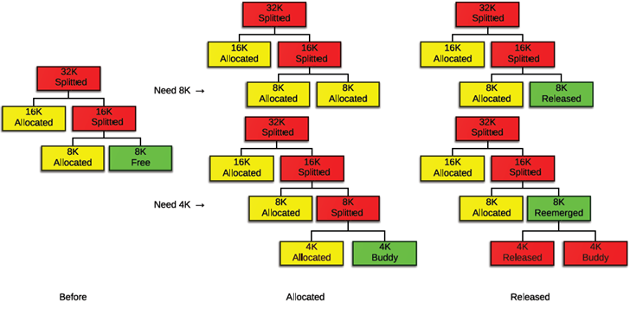
Buddy Memory Allocation
Less (external) fragmentation
Binary buddies, the most common variant
Keeps a tree like structure with depth order n
Block size 2^{n} (or proportional to 2^{n}) –one block can be split into two blocks (two buddies) that are one order lower
On arrival of request of space r, 2^{i-1}<r≤ 2^{i}, find a free block from all current blocks with the order i. If not found, find a free block from all blocks with the order i+1 and split that block into two to make a free block and repeat this recursively until successful allocation
On freeing a block, coalesce the other buddy if it is free to make a block that are one order higher
*Knowlton, Kenneth C. "A fast storage allocator." Communications of the ACM 8.10 (1965): 623-624.
Notes:
In the buddy memory algorithm, the memory is partitioned to satisfy memory requests from programs as efficiently as possible. Here, split the memory into halves to give a best-fit. Buddy memory allocation is relatively easy to implement and it supports limited but efficient splitting and coalescing of memory blocks.
There are various forms of the buddy system, in which each block is subdivided into two smaller blocks. Depending on the incoming block need, multiple smaller blocks near to each other are allocated. The above slide shows how an incoming block is allocated and another case when a block is released.

Slide 33
Non-Contiguous Memory Allocation
Internal/External Fragmentation is common and another way to get rid of them is via non-contiguous memory allocation
PhysicalAddress = address_translation (LogicalAddress)
Although the logical address can be contiguous, the physical address could actually be separated into several chunks in different physical memory location
Although it may not match the users’ (programmers’) view of memory:
It can further reduce fragmentation
Protecting only part of the memory of the processes is possible
Sharing chunks of data will be easier
Better support for swapping and compaction
Virtual memory
Notes:
Non contiguous memory allocation, offers the following advantages over contiguous memory allocation:
Logical address may be contiguous, but the physical address may be non-contiguous.
Sharing chunks of data will be easier. There is better support for swapping and compaction.
External fragmentation is reduced with non contiguous memory allocation.
Virtual memory allocation is strongly supported in non contiguous memory allocation.

Slide 34
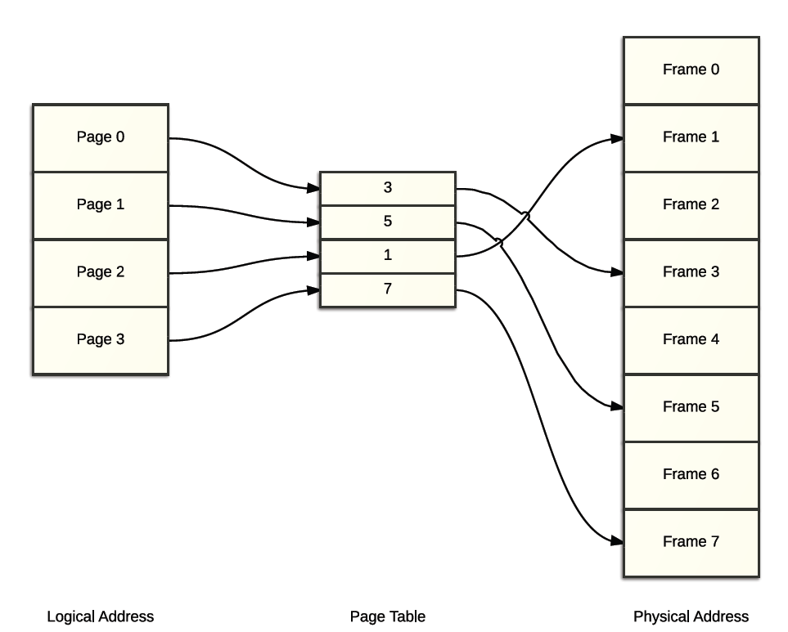
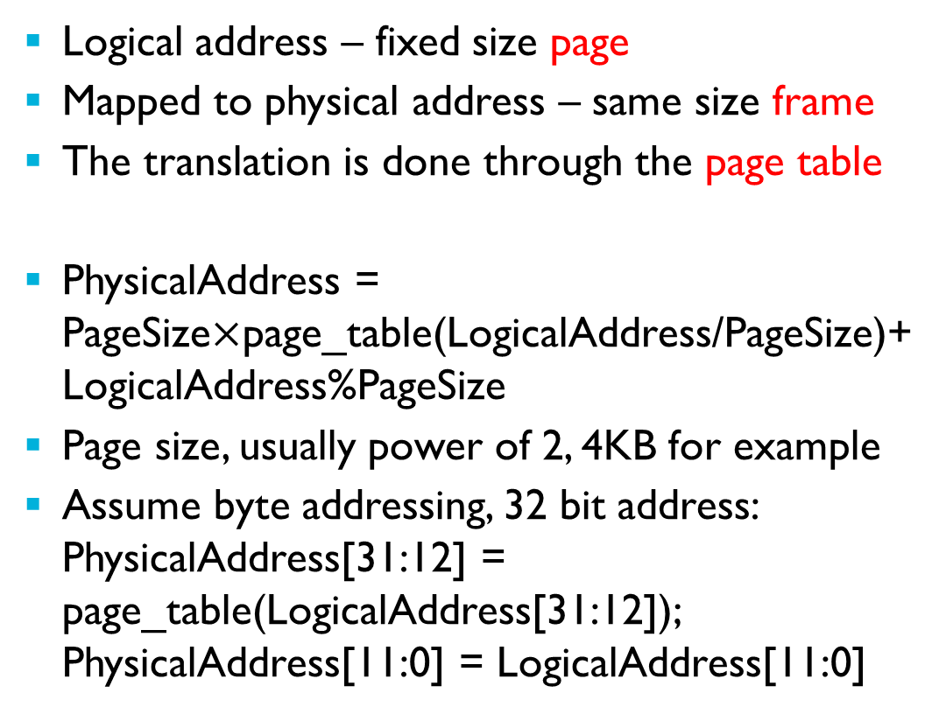
Paging
Logical address – fixed size page
Mapped to physical address – same size frame
The translation is done through the page table
PhysicalAddress = PageSize$×$page_table(LogicalAddress/PageSize)+LogicalAddress%PageSize
Page size, usually power of 2, 4KB for example
Assume byte addressing, 32 bit address: PhysicalAddress[31:12] = page_table(LogicalAddress[31:12]); PhysicalAddress[11:0] = LogicalAddress[11:0]
Notes:
This figure does not include all the details (Base Register). See the figure in the Multilevel Page Table slide.
A large size program is broken into a number of pages in the secondary memory. A few of the pages from secondary memory are brought to main memory. Page size for example can be 4 KB.
Page size on the logical address is same as the frame size at the Physical address. The translation is done through a page table. Page tables map the logical address to a physical address.

Slide 35
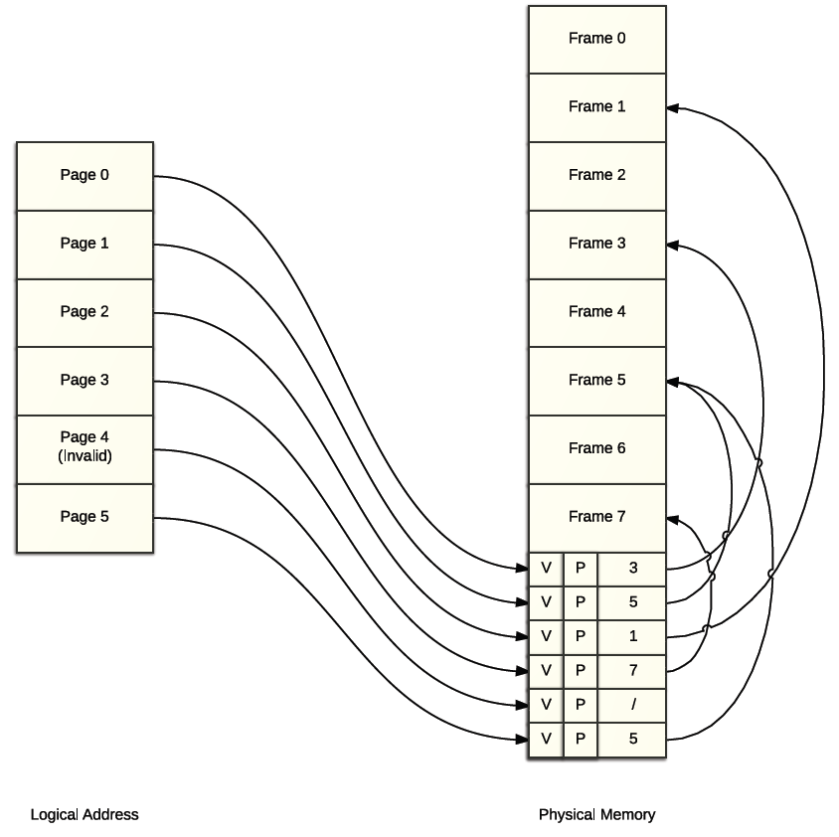
Paging
PT entries can also include
Valid bit
Protection/Mode bits
Other control bits
PT makes sharing a specific chunk of memory simple (Page 1 and Page 5)
PT has to be fast. Where does it reside ?
Register? – fast but limited space
More commonly, kept in the main memory
Two access to memory for every data/instruction access
Notes:
Page tables reside in physical memory and contain the valid bit, protection/mode bits, physical page number corresponding to the logical address and control bits. The next slide shows another view of page table.
The CPU sends a logical address and it is used to access the correct location in the page table which is in the physical memory. From the page table, the actual physical memory address for the requested logical address is found and it is accessed. This means that the physical memory is accessed twice.

Slide 36
Notes:
Taken from Reference: http://www.cs.columbia.edu/~junfeng/10sp-w4118/lectures/l21-page.pdf
The CPU sends a logical (or virtual) address which has two parts– the virtual page number and a page offset. The virtual page number is used to access the page table location. The location contains the physical address frame number. This number is added with the offset to compute the physical address.

Slide 37
Notes:
Taken from Reference: http://www.cs.columbia.edu/~junfeng/10sp-w4118/lectures/l21-page.pdf
Logical address to physical address translation with the help of TLB and PT is shown in the figure.

Slide 38
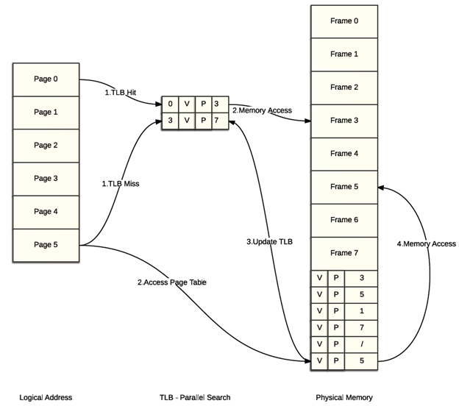
Translation Lookaside Buffer
Cache the PT in a hardware lookup cache
Search for entries parallel in the TLB
If a page is present, then it’s a hit, get the physical address directly
Best case: PhysicalAddress[31:12] = TLB(LogicalAddress[31:12]);
Otherwise, usual sequence – page table then memory
Also needs to update the TLB
Have to be careful about the coherence:
On context switch, flush the TLB
Manage other bits and coordinate with PT
Notes:
We will learn about the Translation Lookaside Buffer (TLB) in this slide.
The TLB is a small cache memory and contains the most recent virtual physical mappings. The TLB helps in obtaining the physical address faster.
The TLB block size is normally 1 or 2 page-table entries and it is cache memory.
If the logical address is found in TLB, then it is a hit and it takes 1 read cycle of TLB to obtain the physical address – example 10 ns.
If there is a miss in the TLB, it causes one page table read cycle.- Example 200 ns.
After each piece of physical memory is accessed, the translation information for logical address to physical address is updated in the TLB.
When there is a context switch, the TLB is flushed.

Slide 39
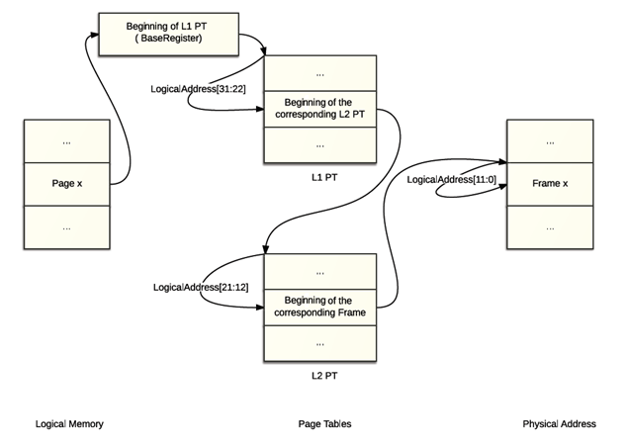
Multilevel Page Table
PT needs 524288 entries for 32-bit address 4kB pages!
Repeat the paging “trick”
PhysicalAddress[31:12] = page_table_L2(page_table_L1(LogicalAddress[31:22]),LogicalAddress[21:12]); PhysicalAddress[11:0] = LogicalAddress[11:0]
You can also keep the TLB!
Notes:
In a 32 bit address, the least significant 12 bits (bits 11:0) are used to access 4K bytes page memory. The most significant 20 bits are split into two 10 bits to access L1 and L2 page tables.

Slide 40
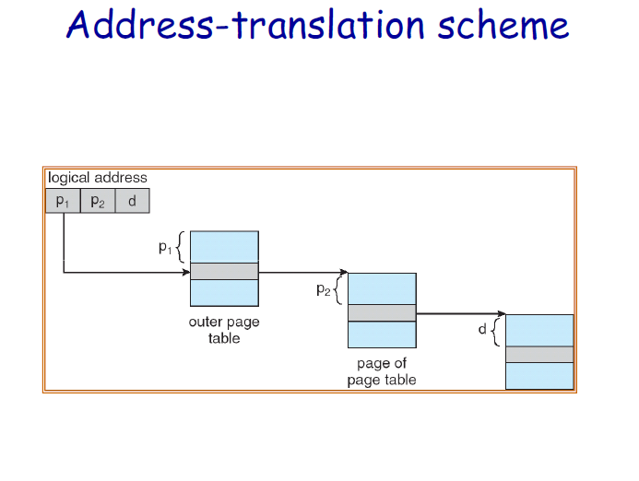
Notes:
A two level page table system is shown in the figure. There are two page tables.

Slide 41
Segmentation With Paging
Although every segment is independent and can grow, shrink, be protected or be shared without affecting each other, managing (multi)segments, particularly with many variables, can be tricky.
Paging better solves the fragmentation (no external fragmentation for paging) and allocation/de-allocation is quick.
Paging however poses extra (rather serious) overhead in terms of address translation and context switching
Modern OSs can combine both
Similar to 2-level paging
Protection/Access mode can be decided on a segment basis
Page table can be more flexible and swapped out
Notes:
The physical memory can be partitioned into segments; different segments may have a different number of pages. The page size is smaller than the segment size. Pages are allocated or de-allocated in main memory, this solves the fragmentation issue. Since segmentation and paging are used, there are overheads in address translation with the segment table and page table. Modern OSs support segments with paging. It is very similar to 2 level paging. Protection and access mode is decided at the segment level. Page table can be more flexible and swapped easily.

Slide 42
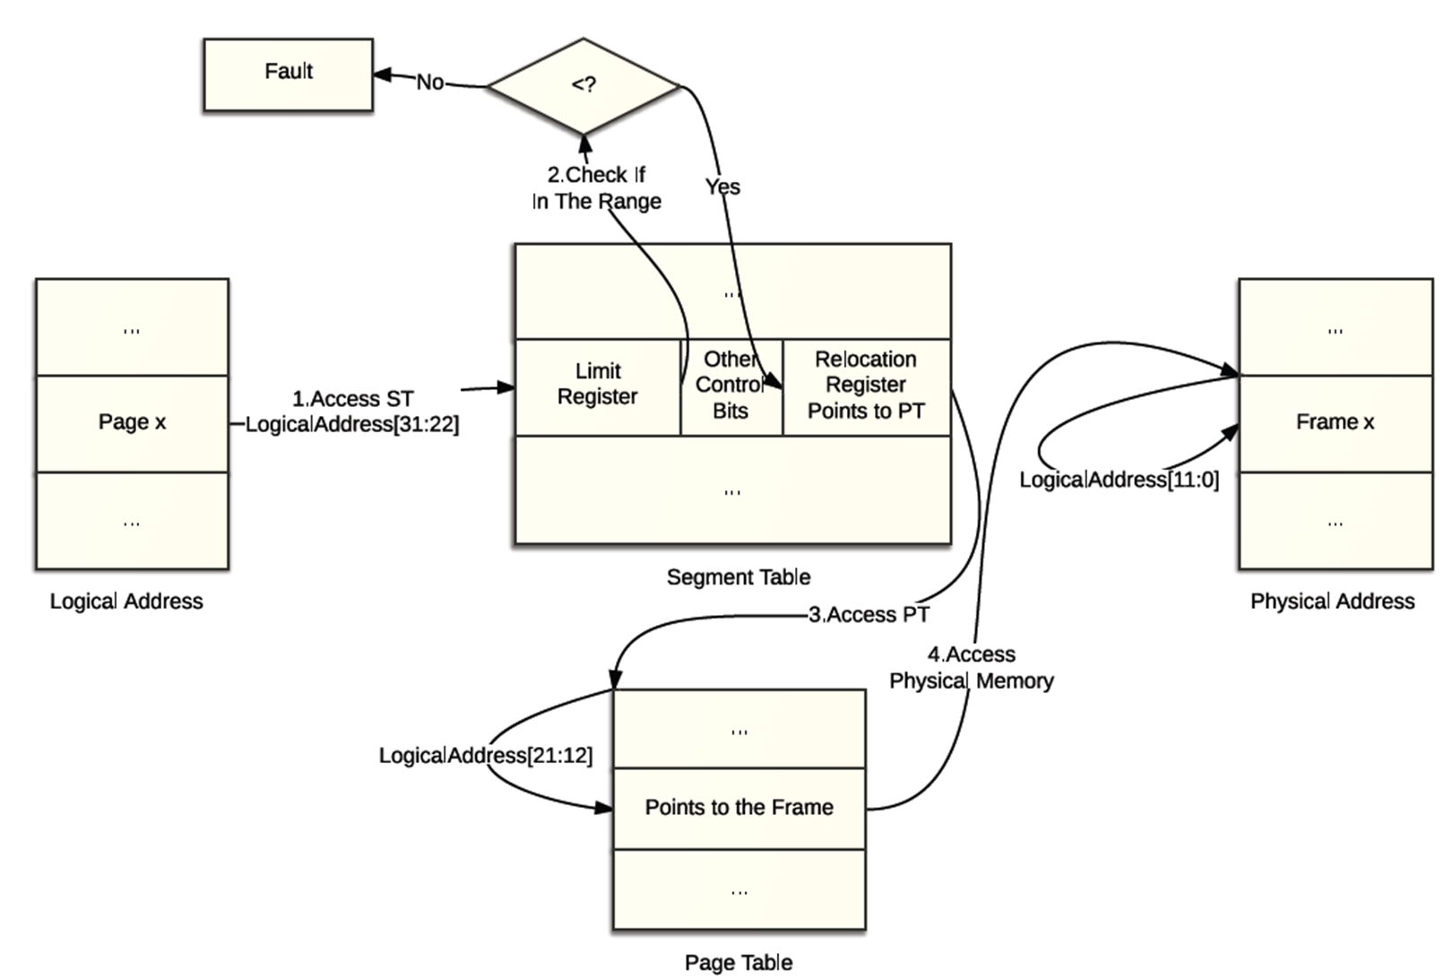
Segmentation With Paging
LogicalAddress:(segment-id, page-id,offset)
Notes:
The segmentation with the paging address translation is shown in the figure.
The most significant 10 bits of the logical address are used to access the segment table. The segment table entry has a limit register which is checked for size/range. This entry also has a page table entry address. The offset for the page table is the logical address bit 21:12. The entry on this location is the physical memory frame number. Frame number with the offset bits 11:0 from the logical address is used to access the physical address.

Slide 43
Next
Virtual Memory
Notes:
A memory management simulation software can be found in this Github repository - https://github.com/szabodabo/Memory-Management-Simulation

